Slide 1
MARKET RESEARCH ON PHONE
P r o f e s s o r e : A l i E L Tayb
P r I n c I p l e s o f S t a t i s t i c s

Slide 2
QUESTIONNAIRE AT GLANCE:
We are group from BIS we made a questionnaire on phones to know what interest use in the phone.
Questionnaire is a set of written questions for obtaining information from individuals. Questionnaire is used when there is a large number of users spread across many geographic locations.
Questionnaire is being distributed in paper or electronic form.
It must be clearly written and leave no room for misunderstanding.
Closed ended questions tend to be mostly common used.
The first step is to select the individual to whom the questionnaire will be sent which called “ SAMPLE”.
The important point in selecting a sample is to realize that not everyone who receives a questionnaire will complete it.
On average , only ( 30% - 50% ) of paper and e-mail questionnaire are returned.
Questionnaire tend to be relatively consistent in style so that the respondent does not have to read the instructions for each question.

Slide 3
GOOD QUESTIONNAIRE DESIGN:
Knowing the goal of questionnaire and the information which you want to gather.
Define your target respondent.
Choose your question type : open ended or closed ended or both of them.
Ensure that you can protect privacy.
Begin with important and interesting questions.
Group items into logically sections.
Do not put important items at the very end of the questionnaire.
Do not crowd a page with too many items.
Avoid abbreviations & biased items.
Number questions to avoid confusion.
Check the length of the questions.
Estimate how long the questionnaire will take.
Make sure that your questionnaire looks professional through check for spelling , grammar and punctuation errors.
Include a deadline : ask a respondents to have the questionnaire completed and returned to you by a certain date to ensure that you have enough time to analyze the results.
Test the questionnaire to identify confusing questions.

Slide 4
The questionnaire was filled by the student of the third level in the BIS program with ages ranges between 19 and 24 with about half of them male and the other half is female
It was made to know the tastes of the youth in BIS in phones and what are the most important aspects they look for
And how we can sell large volume of mobile phones by knowing what they seek for
The problems that we faced as the team in the distribution of the questionnaire firms :
1- It was obvious that not all the students understood all the questions right .
2- Some Students was choosing random answers when facing difficult questions.
3- Some of students didn't prefer to fill the questionnaire and ignored us .
4_ Some of the students wasn't available when the distribution of the questionnaire
because of the lecture and sections time which made us take long time to complete the task.

Slide 5
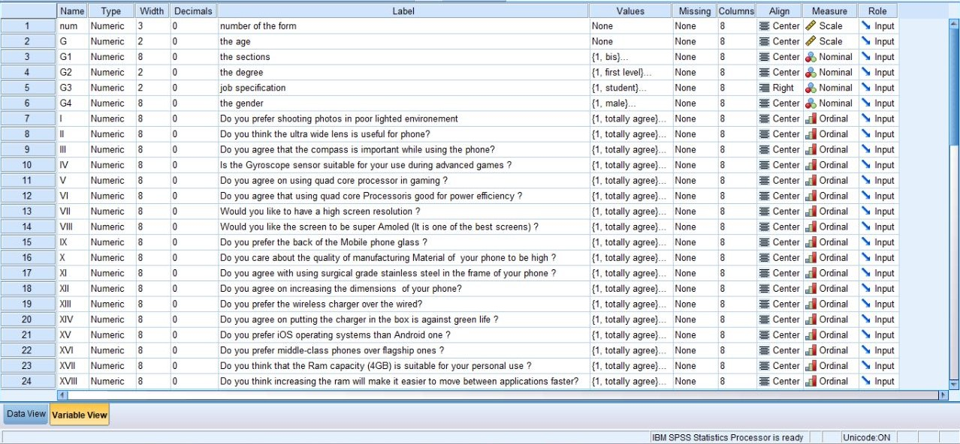
THE DATA SET:

Slide 6
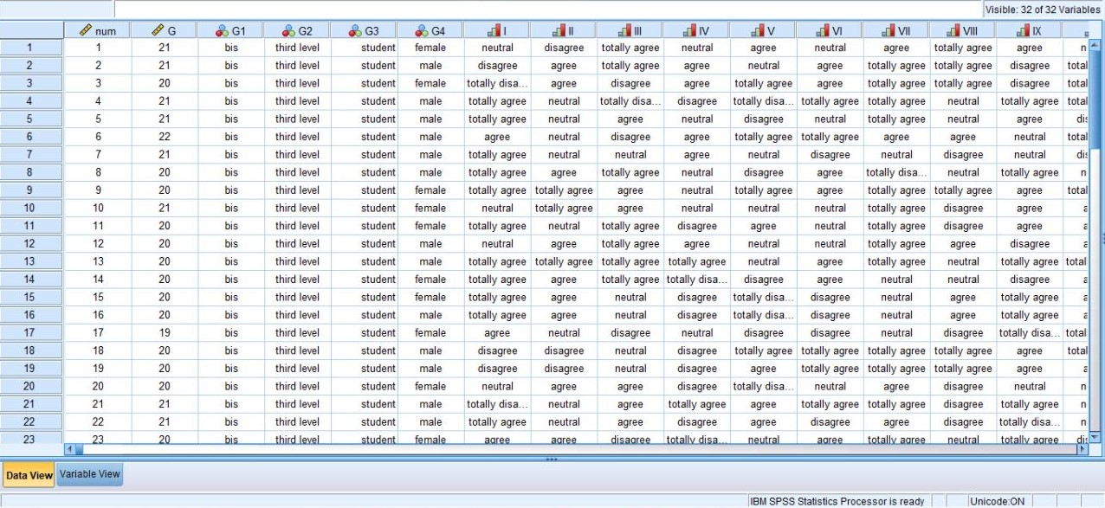
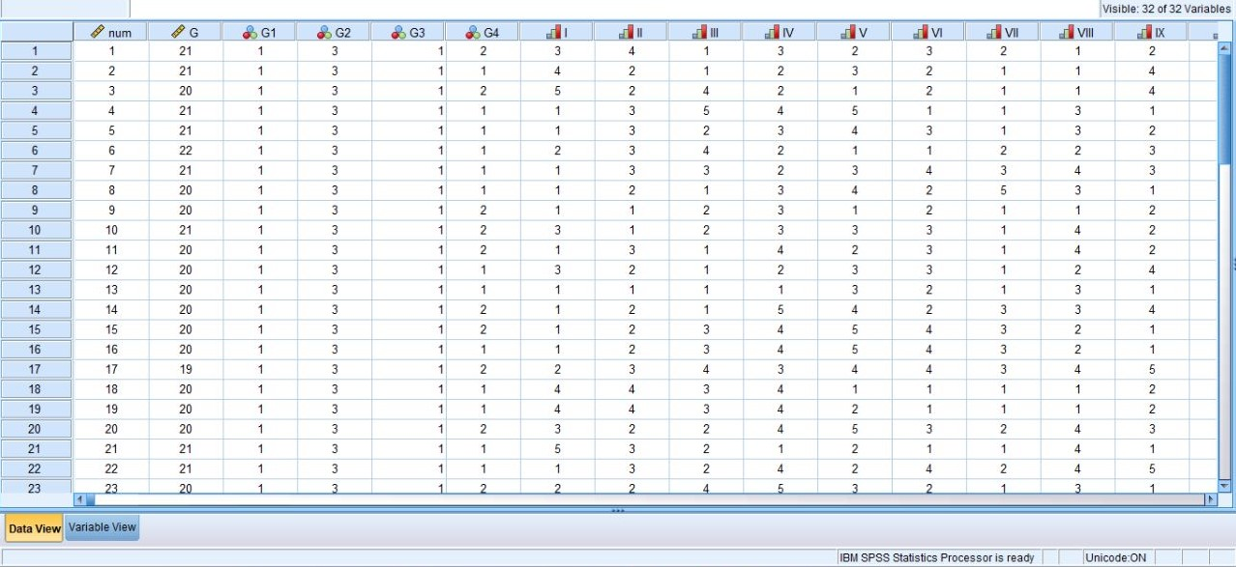
THE DATA ENTRY:

Slide 7
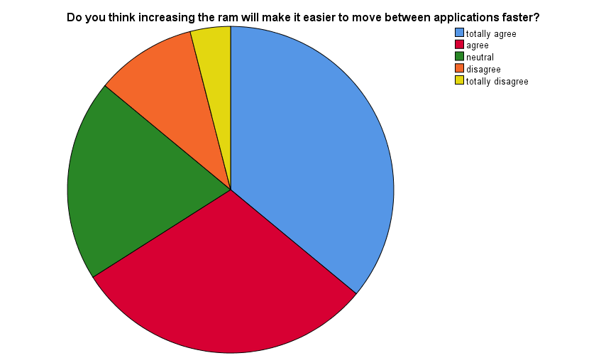
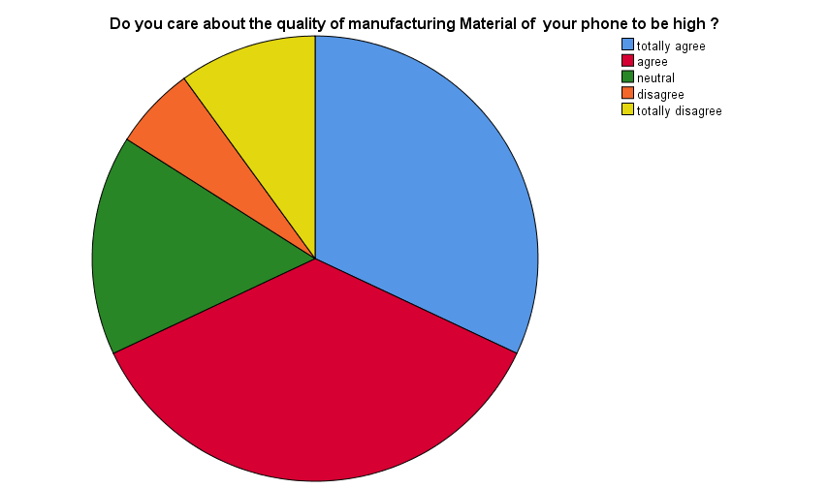
TOP FIVE QUESTIONS IN GENERAL:
Increasing the RAM make it easier to move between applications faster:
With percentage : 66%
For totally agree: 36%
For agree: 30%
High manufacturing quality of the phone:
With percentage: 68%
For totally agree: 32%
For agree: 36%

Slide 8
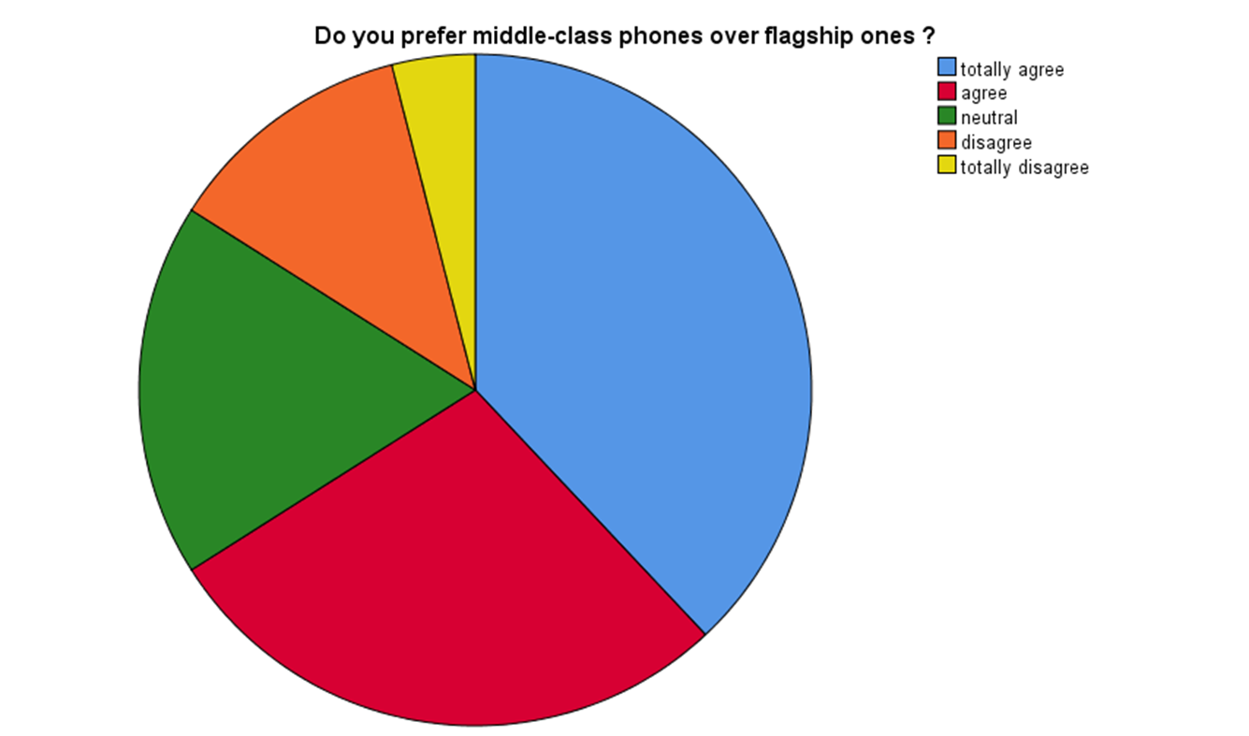
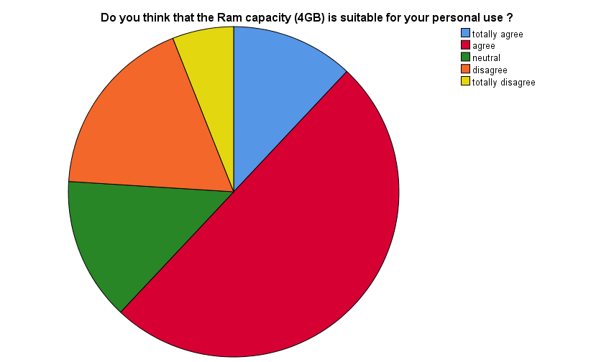
TOP FIVE QUESTIONS IN GENERAL:
Middle-class phones over flagship one:
With percentage: 66%
For totally agree: 38%
For agree: 28%
Four Giga-byte(4GB) RAM is suitable for personal use:
With percentage: 62%
For totally agree: 12%
For agree: 50%

Slide 9
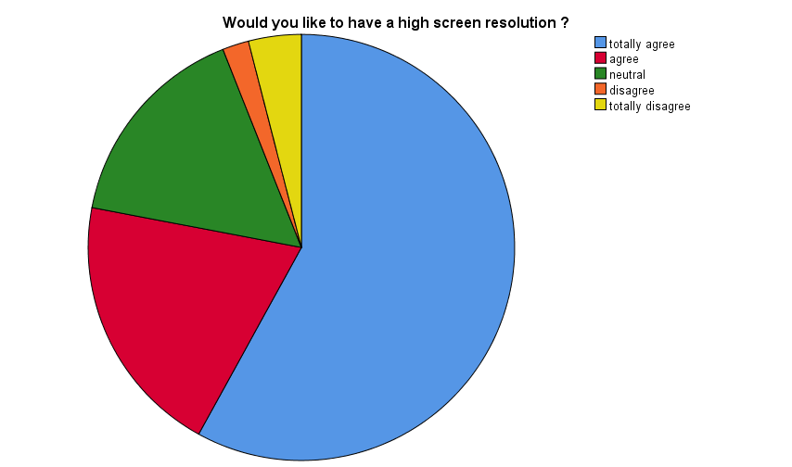
TOP FIVE QUESTIONS IN GENERAL:
High screen resolution:
With percentage: 78%
For totally agree: 58%
For agree: 20%

Slide 10
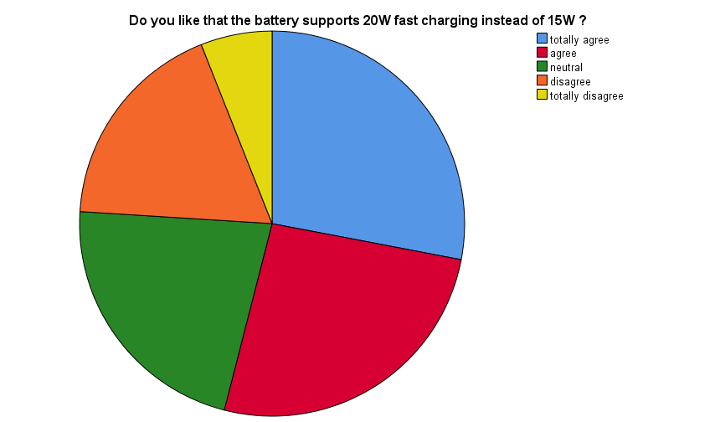
TOP FIVE QUESTIONS FOR MALES:
Four Giga-byte(4GB) RAM is suitable for personal use:
With percentage: 69.2%
For totally agree: 19.2%
For agree: 50%
Battery supports twenty watt(20w) fast charging instead of fifteen watt(15w):
With percentage: 69.3%
For totally agree: 38.5%
For agree: 30.8%

Slide 11
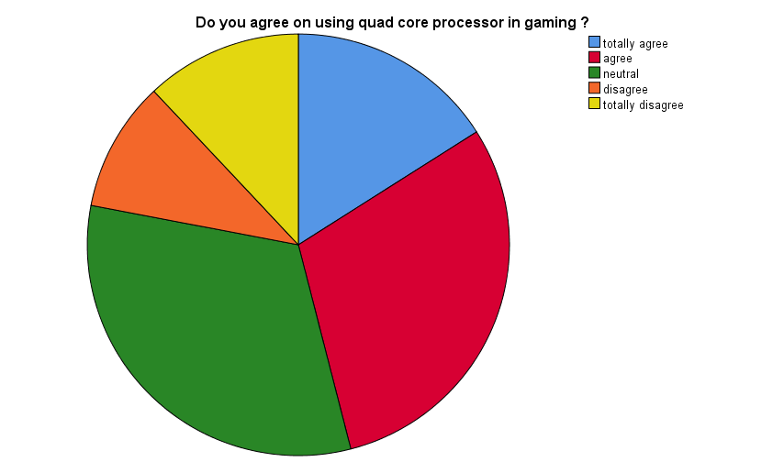
Top five questions for maleS:
High manufacturing quality of the phone:
With percentage: 65.4%
For totally agree: 38.5%
For agree: 26.9%
Quad-core processor for power efficiency:
With percentage: 65.4%
For totally agree: 34.6%
For agree: 30.8%

Slide 12
TOP FIVE QUESTIONS IN MALES:
High screen resolution:
With percentage: 80.7%
For totally agree: 61.5%
For agree: 19.2%

Slide 13

TOP FIVE QUESTIONS FOR FEMALES:
Increasing the RAM make it easier to move between applications faster:
With percentage: 70.9%
For totally agree: 29.2%
For agree: 41.7%
Middle-class phones over flagship one:
With percentage: 70.8%
For totally agree: 33.3%
For agree: 37.5%

Slide 14
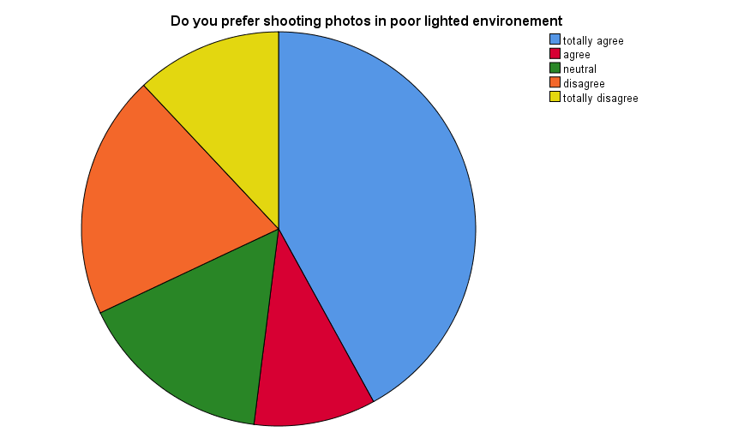
TOP FIVE QUESTIONS FOR FEMALES:
High manufacturing quality of the phone:
With percentage: 70.8%
For totally agree: 25%
For agree: 45.8%
Shooting photos in poor lighted environment:
With percentage: 54.2%
For totally agree: 41.7%
For agree: 12.5%

Slide 15
TOP FIVE QUESTIONS FOR FEMALES:
High screen resolutions:
With percentage: 75%
For totally agree: 54.2%
For agree: 20.8%

Slide 16
CONCLUSION:
We see that the target sample of the BIS was 50 students about half of them boys and half of them are girls With ages ranges between ( 19 – 24 ) and this sample represent 20% of the third level students
The main selling points of the girls are the high screen resolution , high manufacturing quality of the phone , the middle class phones over the flagship , increasing the RAM of the phone by more than four and shooting in dark environment.
The main selling point of the boys are quad core processor , high screen resolution , manufacturing quality ,simple Four Giga-byte and fast charging We see that here boys also focus on the general quality of the phone , having powerful and power efficiency processor with fast charging battery.
Last thing that the main selling points of the whole sample are the gyroscope sensor , general manufacturing quality , middle class phones over the flagship and increasing the RAM So by all of this we see that for large sales volume students ( male and female ) of the BIS mainly focuses on :-
General quality of the phone should by high.
High RAM space of the phone more than Four Giga-bytes.
Middle class phones which reflect that the price should not be high.
High screen resolution us very important for both male and female.

Slide 17
THE MAKERS:
Khadija Ashry mohammed (leader).
Sherwet Shreif Ezzat (subleader).
Afnan Khaled Hassan.
Sandra Sameh Samir.
Mariam Bahaa Sayed.
Shahd Mamdouh Abd EL Basir.
VII. Ahmed Mohammed Refaat.
VIII. Tasneem Wael Saad.
IX. Tasneem Emad Ezzat.
X. Mostafa Ahmed Mostafa.
XI. Mira Hani Samuel.
XII. Sohaila Khaled Abd EL Sabour.
XIII. Sara Mamdouh Diab.

Slide 18
THANK YOU

